Slide 1
Workplace Wellness
An Introduction

Slide 2
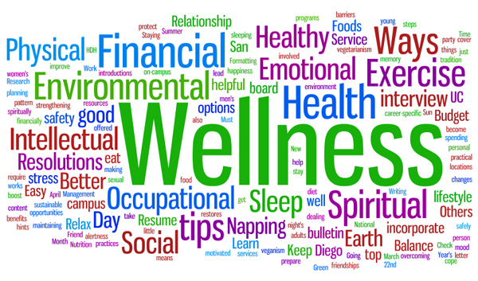
360 °
Notes:
Annikki

Slide 3
360°
A 360°view of Workplace Wellness in Cayman
WHO is responsible?
Annikki Brown Country Manager of Generali Worldwide at IHSL and former Deputy Chair of the Health Insurance Standing Committee of the CIIA
WHAT is Wellness?
Dr. Marc Lockhart (CTMH)
WHY does Wellness matter?
Charles Gilman Patient Representative
Annikki Brown
Three Wellness Programs
Therese Prehay (Public Health Department HSA)
Morven Bodden (Maples HR)
Cynthia Hastings-James (Cookson James Loyalty Inc & BestLifeRewarded.com)
Notes:
Annikki –
Overview of who has contributed. Sectors represented include Medical, Health Insurance, Fitness, Human Resources, Public Health and Overseas Contributors.
WHO is responsible? What does the wellness of employees have to do with the employer?
WHAT is wellness?
The difference between health and wellness
The 7 dimensions of wellness.
Enemies to wellness
WHY does wellness matter?
A testimony of an employee who has had a remarkable difference to his life based on wellness program offered by his employee.
An insurer and employer’s point of view of why wellness matters and how it affects the bottom line

Slide 4
360°
What is in the way? For employees and for employers.
Colleen Brummer (Energy)
Morven Bodden
Getting out of the way? For employees and for employers.
Colleen Brummer
Morven Bodden
AIM: To produce a S.W.O.T. analysis of Wellness in Cayman
Notes:
Annikki

