Slide 1
Moving Toward Improved Health and Better Healthcare: the patient centered approach

Slide 2
The way it has been: Provider-Centered Care
Get sick – go to hospital / Doctor’s office
Facilities & processes geared to efficiency of diagnosis & treatment
Has roots in 19th Century -an era dominated by infectious disease
Patients' didn't expect high levels of care & wellness

Slide 3
Problems with Provider-Centered Care Model
Patients tend to be treated episodically
System burdened with costs of acute care
Patients feel poorly cared for

Slide 4
What has Changed???
Costs out of control
Aging populations
Non- communicable disease rates have eclipsed infectious diseases
Skyrocketing disease burden in less-industrialized countries
Patients expectations

Slide 5
Goals of New Care delivery Models
Improve Health
outcome metrics for chronic & preventive care
Manage and prevent chronic disease
wellness focus
Improve Care
improve patient satisfaction
Improve access,
patient experience
Focus on outcomes
Reduce Cost
Reduce unnecessary acute care
Reduce overutilization

Slide 6
The New Approach
More and higher-quality interaction with provider
Avoid need for treatment, preventive
Better monitoring
Change patient behavior
Share control with patient
Patient is a customer with choices

Slide 7
Reducing Dependence on Physician-based models
Focus on primary care team
Most care from non-physicians
More frequent, longer patient visits
Patient helps shape the plan
Patient access to information
Data mining to uncover risks and gaps
Higher-risk patients get special attention
Outreach, monitoring

Slide 8
New Approach Presents Opportunities for Growing Health Care Systems
Less sunk cost in treatment- & physician-centric models
Build around prevention and wellness
Invest in clinics, outreach, non-physician providers
High-tech, low-cost tools: phone, Web, sensors

Slide 9
New Approach Presents Opportunities for Growing Health Care Systems
Shape medical education around patient-centered
Leverage traditional medicine attitudes
Public education to halt lifestyle slide
Research: Trinidad & diabetes; variation in diet & disease

Slide 10
Patient Centered Medical Home
“The patient‐centered medical home is a model for care provided by physician practices that seeks to strengthen the physician‐patient relationship by replacing episodic care based on illnesses and patient complaints with coordinated care and a long‐term healing relationship”.
(NCQA PPC-PCMH Fact Sheet, www.ncqa.org)

Slide 11
The Medical Home: Reducing Dependence on the Physician
Focus on primary care team
Most care from non-physicians
More frequent, longer patient visits
Outreach, monitoring
Patient helps shape the plan
Patient access to information
Data mining to uncover risks and gaps
Higher-risk patients get special attention

Slide 12
Patient Centered Medical Home Elements
Patient Access
Appointments, Web Portal, Pod system, On-site services
Within visit processes
Group visits
Enhanced EMR technology- new EMR templates
Between visit support
Care coordination , case management, population management
Technology- registry
Patient engagement
Self management support, goal setting
Systems issues
Communicating and coordinating with insurers
Incentives / Staff & provider satisfaction

Slide 13
NCQA Patient-Centered Medical Home 2011 Health care that revolves around you
Must Pass Standards
Access During Office Hours
Implement Continuous Quality Improvement
Using Data for Population Management
Care Management
Self-Care Process
Referral Tracking and Follow-Up

Slide 14
Care Coordination Model: Patient Population
RN case manager
Health coaches
Care
Coordination
Team-
mid-level & support staff

Slide 15
Conclusions
Patient outcomes have improved
Cost has improved
Patient experience has seen variation, with an improvement in access and a decline in communication
Provider and staff experience has worsened
Value = Outcomes + Experience
Cost
Notes:
DETAIL IN Q+A

Slide 16
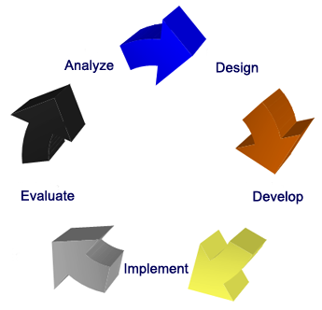
Operations Training
Orientation & Systems Training
Competency - Based Skills Assessment
Practice Assessment & Optimization
Patient & Provider Portal Support

Slide 17
Where to start? Readiness Assessment
Phase 1 | Phase 2 | Phase 3
Building the Team and Culture | Transformation | Advanced Practices
Readiness assessment- completed by PA & OMD | Implement team role changes | Complete open and advanced access
Education- what is PCMH? (kickoff presentation) | On site patient education classes are provided routinely | Secure patient messaging
Education- 4 PCMH training modules in MyLearning | Build the patient partnership- communication, expectations | Site level PI team
Identify team roles and responsibities- working to the highest level of license, learn about staff optimization goals | Address gaps from readiness assessment- education provided by Best Practices | Care plan development- identify self-care needs, establish goals, identify barriers, and monitor effectives
Identify roles of PA and OMD & transportation team members | Access management- assessing needs and controlling demand | High risk patient identification
Provider engagement- OMD lead & identify expectations | Population health management | Site level patient focus groups
 | Care coodination- transitions of care | Advanced care coordination- case mgmt and additional services
Notes:
Assessment tool
Attached is the plan I am using for PCMH transformation (tab 1 labeled phases). This provides structure to the transformation work and assures that all needs are considered. Much of the work around moving from one phase to the next is around change management and assuring that the foundation is solid when moving to the next phase. When sites are presented with all that is needed to become a PCMH, it is overwhelming. This breaks it down for them. It is designed to be self paced when moving to each phase. So one practice may achieve phase 1 quicker than another.
In phase 1, there is a readiness assessment (tab 2). This is completed by the practice leadership team and is designed to be a self reflective process of how the practice currently operates. Phase 2 works on addressing those gaps through the implementation of processes. We have best practice guidelines to give the practices to learn ways to achieve each of the tasks.
Tab 3 is a outline of staff roles. The goal in phase 2 is to get staff working to the highest level of their license and identify the competencies that are needed for each of the team members to perform those tasks. We do an initial workflow assessment with the site and identify opportunities to update workflows for workforce optimization. This is very similar to the Lean assessment process.

Slide 18
Diabetes Group Visits
Effective at improving HgbA1C
Patients with: (n) | Baseline A1C | 1st Post-class A1C | Most Recent A1C
New DM dx (36) | 8.65 | 6.56 | 6.80
Current DM (31) | 8.36 | 7.45 | 7.49
Referral who did not attend (31) | 8.12 |  | 8.07

Slide 19
Patient Experience (CAHPS) Access
Access scores have improved significantly over the past 3 years

Slide 20
Patient Experience (CAHPS) Communication
Communication scores have declined
Analysis of this indicates 3 providers with low scores have brought the site average down

Slide 21
Challenges
Care coordination – peri-hospital and specialty care transitions
Engaging patients for behavior change
Mental health
Technology –
development requires resources, time
Information exchange: tech & HIPPA issues
Pay structures and aligning incentives
Resource allocation – short vs. long term focus
Clinician satisfaction
Notes:
SAVE FOR Q+A

Slide 22
Align with Pay for Performance Programs within JHCP
Value Based Purchasing (JHHC)
Meaningful Use of EHR’s
Patient Centered Medical Home (PCMH)
Maryland Multi-Payer Pilot (MMPP)- 5 sites
CareFirst
USFHP
ACO- ready
PQRS
ePrescribing
Maryland State-Regulated Payer EHR Adoption Incentive Program
Notes:
SAVE FOR Q+A
Align goals, key to success. Use p4p to fund. Demonstrate value. Increase scope and population base.

Slide 23
Lessons Learned
Change = time + patience + plan
Plan
Clearly defined, measurable goals
Written
Timeline
Communication
Incentives
Data
Notes:
TAKE ADVANTAGE OF LHN: PILOTS, RESOURCES, CONTACTS
WE HAVE A MICROSYSTEM HERE IN MUSKEGON; WE CAN MAKE THIS COMMUNITY PROVIDE GREAT HEALTH CARE. MY VISION IS AN INTEGRATED COMMUNITY, BUT STARTS WITH A STRONG INFRASTRUCTURE OF PRIMARY CARE
We all need incentives; sometimes big picture sometimes small tangible things (staff); gets us through challenges, like change fatigue
Know your data: measure it and track it

Slide 24
Participation in Collaborative Care Model
Within the next three years, will your organization participate in a collaborative care model, such as an accountable care organization or patient-centered medical home?
Base = 292 Source: Physician Alignment: The Collaborative Care Disconnect, HealthLeaders Media, September 2011

Slide 25
The ALIKI INITIATIVE: Knowing the Patient as a Person

Slide 26
The Aliki Initiative: Challenge
Sir William Osler observed: “It is more important to know what sort of person has a disease than what sort of disease a person has.”
Yet--60% of Americans say their doctor does not know them
Notes:
26

Slide 27
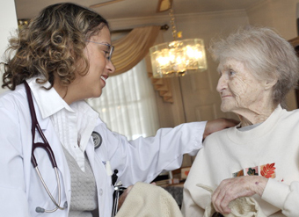
The Aliki Initiative: Goals
Create a culture that values knowing the patient well
Fewer patients
More time spent with patients
Call every patient
Visit patients at home
Notes:
27

Slide 28
The Aliki Initiative:
Began October 2007
Curriculum, teaching, rounds focused on knowing patients as individuals
Focus on evidence-based diagnosis and treatment tailored to individual patient
Telephone calls to all patients after discharge
Telephone calls to primary care providers
Medication adherence assessments
Home visits and visits to sub-acute rehab

Slide 29
Aliki and Readmissions
Poor care coordination is a major cause of readmission.
Improving patients’ understanding of illness, management of illness and medications, appreciation of important signs and symptoms are felt to be key strategies to reduce readmissions.
Disease management programs (DMPs) have been established to reduce readmissions for specific conditions like CHF and COPD.

Slide 30
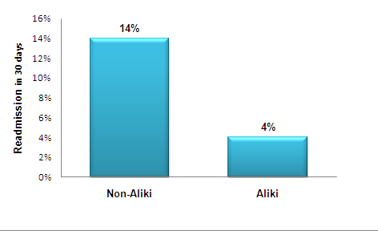
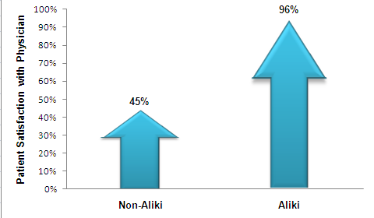
Aliki Initiative Outcomes
CHF Readmission
Patient Satisfaction
p=0.04
p=0.003
*Arch Intern Med 2011; 171 :858., J Gen Intern Med

Slide 31
What Do Residents Think? Highest Rating of 9 (Outstanding)
Item | Aliki Team (N = 51) | Standard Team (N = 163) | P value
Improving knowledge of patients as people | 43% | 17% | < 0.01
Improving degree to which you addressed patient adherence | 43% | 14% | < 0.01
Improving your communication with patients about transition from hospital | 47% | 17% | < 0.01
Improving knowledge base | 22% | 18% | NS
Improving clinical reasoning and judgment | 22% | 21% | NS
Overall rating | 29% | 16% | 0.04

Slide 32
What Do Patients Think?
Patient Satisfaction Domains | Aliki Team (N=117) | Standard Team (N = 924) | P value
Room | 13% | 10% | 0.68
Meals | 15% | 5% | 0.11
Nurses | 20% | 12% | 0.48
Physicians | 97% | 47% | < 0.01
Time physician spent with you | 99% | 50% | < 0.01
Physician concern for your questions and worries | 99% | 44% | < 0.01
How well physician kept you informed | 99% | 55% | < 0.01
Friendliness/courtesy of physician | 95% | 50% | 0.02
Skill of physician | 80% | 22% | 0.02
Overall hospital experience | 95% | 60% | 0.08
Percentile rankings are derived from local mean scores compared to mean scores from every other hospital participating in the Press-Ganey survey from Oct 2007 – Feb 2009

Slide 33
The way Forward…
Moving Toward Improved Health and Better Healthcare using a the patient-centered approach

